Slide 1

Recursion

Slide 2
This Lecture
Recursion is one of the most important techniques in computer science.
The main idea is to “reduce” a problem into smaller problems.
Setting up recurrences
  Fibonacci recurrence
  Catalan recurrence
  Other recurrences
Writing recursive program
Solving recurrences

Slide 3
Recursively Defined Sequences
We can define a sequence by specifying relation between
the current term and the previous terms.
Arithmetic sequence: (a, a+d, a+2d, a+3d, …, )
recursive definition: a₀=a, a_{i+1}=a_{i}+d
Geometric sequence: (a, ra, r²a, r³a, …, )
recursive definition: a₀=a, a_{i+1}=ra_{i}
Harmonic sequence: (1, 1/2, 1/3, 1/4, …, )
recursive definition: a₀=1, a_{i+1}=ia_{i}/(i+1)

Slide 4
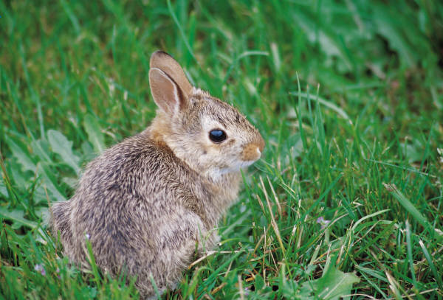
Rabbit Populations
The Rabbit Population
A mature boy/girl rabbit pair reproduces every month.
Rabbits mature after one month.
w_{n}::= # newborn pairs after n months
r_{n}::= # reproducing pairs after n months
Start with a newborn pair: w₀ =1, r₀ = 0
How many rabbits after n months?

Slide 5
Rabbit Populations
w_{n}::= # newborn pairs after n months
r_{n}::= # reproducing pairs after n months
r₁ = 1
r_{n} = r_{n-1} + w_{n-1}
w_{n} = r_{n-1} so
r_{n} = r_{n-1} + r_{n-2}
It was Fibonacci who was studying rabbit population growth.
We will compute the closed form for r_{n} later in this lecture…

Slide 6
Warm Up
We will solve counting problems by setting up recurrence relations.
First we use recursion to count something we already know,
to get familiar with this approach.
Let us count the number of elements in pow(S_{n})
where S_{n} = {a₁, a₂, …, a_{n}} is an n-element set.
Let r_{n} be the size of pow(S_{n}).
Then r₁ = 2, where pow(S₁) = {Ф, {a₁}}
r₂ = 4, where pow(S₂) = {Ф, {a₁}, {a₂}, {a₁,a₂}}
r₃ = 8, where pow(S₃) = {Ф, {a₁}, {a₂}, {a₃} {a₁,a₂} {a₁,a₃}, {a₂,a₃}, {a₁,a₂,a₃}}
We know this already
r_{n} = 2^{n}
But we will compute again

Slide 7
Warm Up
Let r_{n} be the size of pow(S_{n}) where S_{n} = {a₁, a₂, …, a_{n}} is an n-element set.
Then r₁ = 2, where pow(S₁) = {Ф, {a₁}}
r₂ = 4, where pow(S₂) = {Ф, {a₁}, {a₂}, {a₁,a₂}}
r₃ = 8, where pow(S₃) = {Ф, {a₁}, {a₂}, {a₃} {a₁,a₂} {a₁,a₃}, {a₂,a₃}, {a₁,a₂,a₃}}
The main idea of recursion is to define r_{n} in terms of the previous r_{i}.
How to define r₃ in terms of r₁ and r₂?
pow(S₃) = the union of {Ф, {a₁}, {a₂}, {a₁,a₂}}
and {a₃, {a₁,a₃}, {a₂,a₃}, {a₁,a₂,a₃}}
pow(S₂)
while the lower sets are obtained by adding a₃ to the upper sets.
So r₃ = 2r₂.

Slide 8
Warm Up
Let r_{n} be the size of pow(S_{n}) where S_{n} = {a₁, a₂, …, a_{n}} is an n-element set.
The main idea of recursion is to define r_{n} in terms of the previous r_{i}.
pow(S_{n}) = the union of S_{n-1} = {Ф, {a₁}, {a₂}, …, {a₁,a₂,…,a_{n-1}}}
and {a_{n}, {a₁,a_{n}}, {a₂,a_{n}}, …, {a₁,a₂,…,a_{n-1},a_{n}}}
while the lower sets are obtained by adding a_{n} to the upper sets.
Every subset is counted exactly once.
So r_{n} = 2r_{n-1}.
Solving this recurrence relation will show that r_{n} = 2^{n} (geometric sequence).

Slide 9
Number of Bit Strings without a Specific Pattern
How many n-bit strings are there without the bit pattern 11?
Let r_{n} be the number of such strings.
e.g. r₁ = |{0, 1}| = 2,
r₂ = |{00, 01, 10}| = 3
r₃ = |{000, 001, 010, 100, 101}| = 5
r₄ = |{0000, 0001, 0010, 0100, 0101, 1000, 1001, 1010}| = 8
Can you see the pattern?
r₄ = |{0000, 0001, 0010, 0100, 0101} union
{1000, 1001, 1010}|
= 5 + 3 = 8

Slide 10
Number of Bit Strings without a Specific Pattern
How many n-bit strings are there without the bit pattern 11?
Let r_{n} be the number of such strings.
How do we compute it using r₁,r₂,…,r_{n-1}?
Case 1: The first bit is 0.
Then any (n-1)-bit string without the bit pattern 11
can be appended to the end to form a n-bit string without 11.
So in this case there are exactly r_{n-1} such n-bit strings.
00000000000000000
00000000000000001
…
1010101010101010101
The set of all (n-1)-bit
strings without 11.
Totally r_{n-1} of them.
0
+

Slide 11
Number of Bit Strings without a Specific Pattern
How many n-bit string without the bit pattern 11?
Let r_{n} be the number of such strings.
How do we compute it using r₁,r₂,…,r_{n-1}?
Case 2: The first bit is 1.
Then the second bit must be 0, because we can’t have 11.
Then any (n-2)-bit string without the bit pattern 11
can be appended to the end to form a n-bit string without 11.
So in this case there are exactly r_{n-2} such n-bit strings.
0000000000000000
0000000000000001
…
101010101010101010
The set of all (n-2)-bit
strings without 11.
Totally r_{n-2} of them.
10
+

Slide 12
Number of Bit Strings without a Specific Pattern
How many n-bit string without the bit pattern 11?
Let r_{n} be the number of such strings.
How do we compute it using r₁,r₂,…,r_{n-1}?
00000000000000000
00000000000000001
…
1010101010101010101
The set of all (n-1)-bit
strings without 11.
Totally r_{n-1} of them.
0
+
0000000000000000
0000000000000001
…
101010101010101010
The set of all (n-2)-bit
strings without 11.
Totally r_{n-2} of them.
10
+
Therefore, r_{n} = r_{n-1} + r_{n-2}

Slide 13
In-Class Exercise
How many n-bit string without the bit pattern 111?
Let r_{n} be the number of such strings.
r_{n-1}
0
+
10
+
r_{n-2}
r_{n-3}
110
+
r_{n} = r_{n-1} + r_{n-2} + r_{n-3}

Slide 14
Domino
Given a 2xn puzzle, how many ways to fill it with dominos (2x1 tiles)?
3
3
3
2
E.g. There are 3 ways to fill a 2x3 puzzle with dominos.
Let r_{n} be the number of ways to fill a 2xn puzzle with dominos.
How do we compute it using r₁,r₂,…,r_{n-1}?

Slide 15
Domino
Given a 2xn puzzle, how many ways to fill it with dominos (2x1 tiles)?
Let r_{n} be the number of ways to fill a 2xn puzzle with dominos.
Case 1: put the domino vertically
r_{n-1} to fill the remaining 2x(n-1) puzzle
Case 2: put the domino horizontally
r_{n-2} to fill the remaining 2x(n-2) puzzle
Therefore, r_{n} = r_{n-1} + r_{n-2}

Slide 16
This Lecture
Setting up recurrences
  Fibonacci recurrence
  Catalan recurrence
  Other recurrences
Writing recursive program
Solving recurrences

Slide 17
Parenthesis
How many valid ways to add n pairs of parentheses?
E.g. There are 5 valid ways to add 3 pairs of parentheses.
((())) (()()) (())() ()(()) ()()()
Let r_{n} be the number of ways to add n pairs of parentheses.
How do we compute it using r₁,r₂,…,r_{n-1}?

Slide 18
Parenthesis
How many valid ways to add n pairs of parentheses?
Let r_{n} be the number of ways to add n pairs of parentheses.
Case 1:
()--------------------
So there are r_{n-1} in this case.
r_{n-1} ways to add the remaining n-1 pairs.
Case 2:
(--)------------------
So there are r_{n-2} in this case.
1 way to add 1 pair
r_{n-2} ways to add the remaining n-2 pairs.
Case 3:
(----)----------------
So there are 2xr_{n-3} in this case.
2 ways to add 2 pairs
r_{n-3} ways to add the remaining n-3 pairs.

Slide 19

Parenthesis
How many valid ways to add n pairs of parentheses?
Let r_{n} be the number of ways to add n pairs of parenthese.
Case k+1:
(----------)----------
r_{k} ways to add k pairs
r_{n-k-1} ways to add the remaining n-k-1 pairs.
By the product rule, there are r_{k}r_{n-k-1} ways in case k.
The cases are depended on the position of the matching
close parenthesis of the first open parenthesis,
and so these cases are disjoint.
Therefore, by the sum rule,

Slide 20
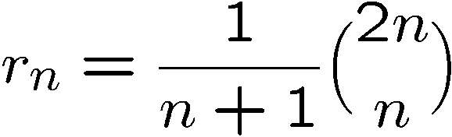
Parenthesis
How many valid ways to add n pairs of parentheses?
It turns out that r_{n} has a very nice formula:
We are not deriving it here…
This is called the Catalan number.
There are many combinatorial applications of this formula.

Slide 21
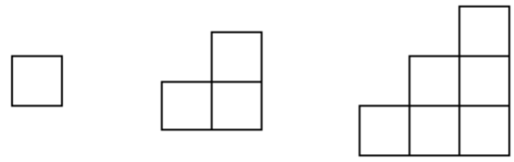

Stairs
An n-stair is a collection of squares as follows:
For example 1-stair, 2-stair, and 3-stair are like this:
How many ways to fill up the n-stair by exactly n rectangles??
For example, there are 5 ways to fill up the 3-stair by 3 rectangles.

Slide 22
Stairs
Let r_{n} be the number of ways to fill the n-stair by n rectangles.
How do we compute it using r₁,r₂,…,r_{n-1}?
6
5
4
3
2
1
Given the n-stair, the first observation is that the positions on the
diagonal (red numbers) must be covered by different rectangles.
Since there are n positions in the diagonal and we can only use n rectangles,
each rectangle must cover exactly one red number.

Slide 23
Stairs
Let r_{n} be the number of ways to fill the n-stair by n rectangles.
How do we compute it using r₁,r₂,…,r_{n-1}?
6
5
4
3
2
1
o
Consider the rectangle R that covers the bottom right corner (marked with o).
We consider different cases depending on which red number that R contains.

Slide 24
Stairs
Let r_{n} be the number of ways to fill the n-stair by n rectangles.
How do we compute it using r₁,r₂,…,r_{n-1}?
6
5
4
3
2
1
o
Suppose R contains 3. Then observe that the 6-stair is divided into 3 parts.
One part is the rectangle R. The other two parts are a 2-stair and a 3-stair.
Therefore, in this case, the number of ways to fill in the remaining parts
is equal to r₂r₃

Slide 25
Stairs
Let r_{n} be the number of ways to fill the n-stair by n rectangles.
How do we compute it using r₁,r₂,…,r_{n-1}?
6
5
4
3
2
1
o
Similarly suppose R contains 2.
Then the rectangle “breaks” the stair into a 1-stair and a 4-stair.
Therefore, in this case, the number of ways to fill in the remaining parts
is equal to r₁r₄

Slide 26
Stairs
Let r_{n} be the number of ways to fill the n-stair by n rectangles.
How do we compute it using r₁,r₂,…,r_{n-1}?
n
…
…
i
…
1
o
In general suppose the rectangle contains i
Then the rectangle “breaks” the stair into a (i-1)-stair and a (n-i)-stair.
Therefore, in this case, the number of ways to fill in the remaining parts
is equal to r_{i-1}r_{n-i}

Slide 27
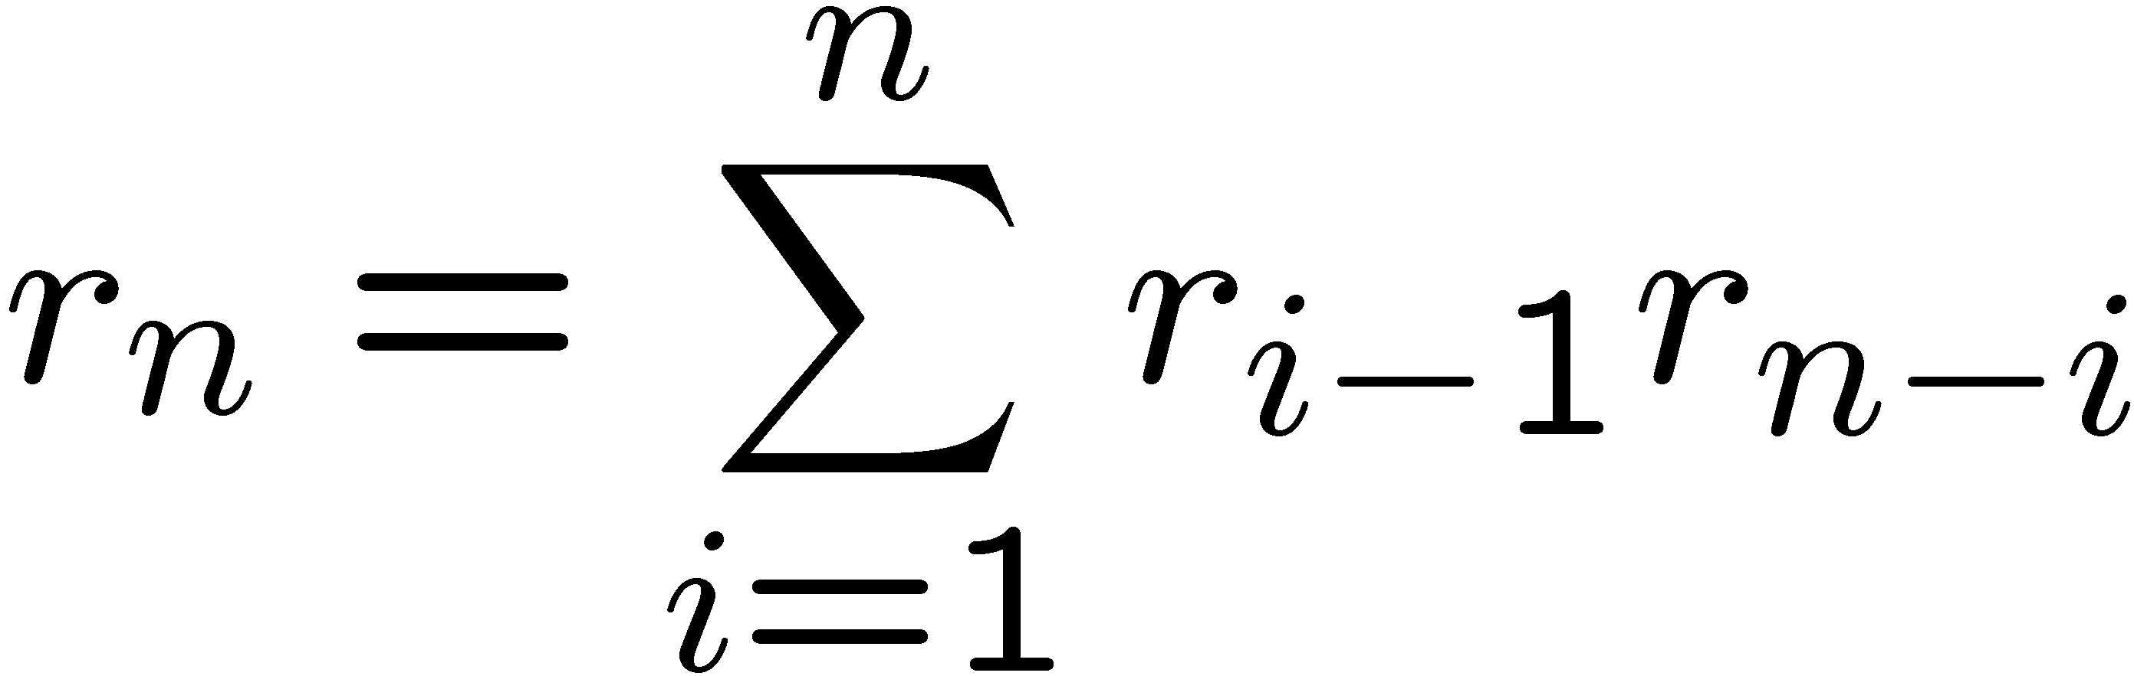
Stairs
The number of ways to fill in the remaining parts is equal to r_{i-1}r_{n-i}
n
…
…
i
…
1
o
Rectangle R containing different i will form different configurations,
and each configuration must correspond to one of these cases.
Therefore the total number of ways is equal to

Slide 28
This Lecture
Setting up recurrences
  Fibonacci recurrence
  Catalan recurrence
  Other recurrences
Writing recursive program
Solving recurrences

Slide 29
Number of Partitions
How many ways to partition n elements into r non-empty groups?
S(4,4)=1 {x1} {x2} {x3} {x4}
{x1 x2} {x3 x4}
{x1 x3} {x2 x4}
{x1 x4} {x2 x3}
{x1} {x2 x3 x4}
{x2} {x1 x3 x4}
{x3} {x1 x2 x4}
{x4} {x1 x2 x3}
{x1 x2} {x3} {x4}
{x2 x3} {x1} {x4}
{x1 x3} {x2} {x4}
{x2 x4} {x1} {x3}
{x1 x4} {x2} {x3}
{x3 x4} {x1} {x2}
S(4,2)=7
S(4,3)=6

Slide 30
Number of Partitions
How many ways to partition n elements into r non-empty groups?
Let S(n,r) be the number of ways to partition n elements into r groups.
Case 1: The element n forms its own group.
{xn} ……………
Then any partition of the remaining n-1 elements
into r-1 groups can be appended to form a parititon
of n elements into r groups.
So there are S(n-1,r-1) ways in this case.

Slide 31
Number of Partitions
How many ways to partition n elements into r non-empty groups?
Let S(n,r) be the number of ways to partition n elements into r groups.
Case 2: The element n is NOT in its own group.
given any partition of the remaining n-1 elements into r groups,
we can extend it in r different ways,
and any partition in case 2 can be obtained in this way.
{x1,x5},{x2,x6,x7},{x3,x11},……,{x4,x12}
{xn}
{xn}
{xn}
{xn}
So there are rS(n-1,r) ways to partition in this case.

Slide 32
Number of Partitions
How many ways to partition n elements into r non-empty groups?
Let S(n,r) be the number of ways to partition n elements into r groups.
Case 1: The element n forms its own group.
So there are S(n-1,r-1) ways in this case.
Case 2: The element n does NOT form its own group.
So there are rS(n-1,r) ways to partition in this case.
These two cases are disjoint, thus by the sum rule, we have
S(n,r) = S(n-1,r-1) + rS(n-1,r)

Slide 33
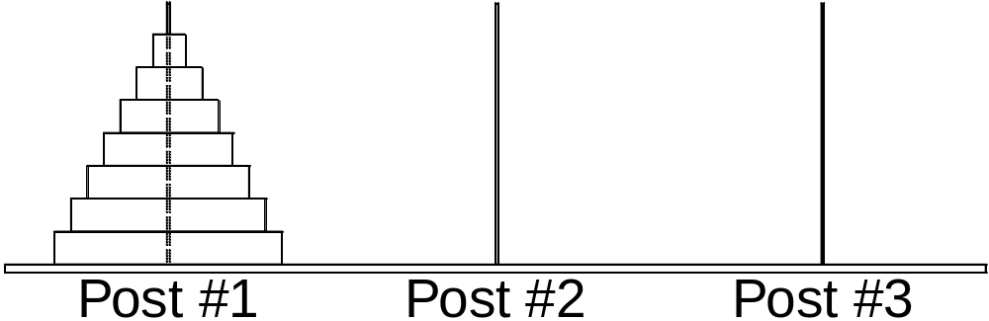
Tower of Hanoi
The goal is to move all the disks to post 3.
The rule is that a bigger disk cannot be placed on top of a smaller disk.

Slide 34
Tower of Hanoi
It is easy if we only have 2 disks.
A total of 3 steps.

Slide 35
Tower of Hanoi
It is not difficult if we only have 3 disks.
Continue in next page

Slide 36
Tower of Hanoi
It is not difficult if we only have 3 disks.
A total of seven steps.

Slide 37
Tower of Hanoi
Can you write a program to solve this problem?
Think recursively!

Slide 38
Tower of Hanoi
Suppose you already have a program for 3 disks.
Can you use it to solve 4 disks?
In order to move the largest disk,
I have to move the top 3 disks first,
and I can use the program for 3 disks.
Then I move the largest disk.
Then I can use the program to move
the 3 disks from pole 2 to pole 3.
Since the program requires 7 steps,
the total number of steps is 15.

Slide 39
Tower of Hanoi
This recursion is true for any n.
In order to move the largest disk,
I must move the top n-1 disks first,
and I can use the program for n-1 disks.
Then I move the largest disk.
Then I can use the program again to move
the n-1 disks from pole 2 to pole 3.
Since the program requires r_{n-1} steps,
the total number of steps is 2r_{n-1} + 1.
r_{n} = 2r_{n-1} + 1

Slide 40
Merge Sort
Given a sequence of n numbers,
how many steps are required to sort them into non-decreasing order?
One way to sort the number is called the “bubble sort”,
in which every step we search for the smallest number,
and move it to the front.
This algorithm could take up to roughly n² steps.
For example, if we are given the reverse sequence n,n-1,n-2,…,1.
Every time it will search to the end to find the smallest number,
and the algorithm takes roughly n+(n-1)+(n-2)+…+1 = n(n+1)/2 steps.
Can we design a faster algorithm?
Think recursively!

Slide 41
Merge Sort
Suppose we have a program to sort n/2 numbers.
We can use it to sort n numbers in the following way.
3 8 4 7 2 1 6 5
Divide the sequence into two halves.
Use the program to sort the two halves independently.
3 4 7 8
1 2 5 6
With these two sorted sequences of n/2 numbers,
we can merge them into a sorted sequence of n numbers easily!

Slide 42
Merge Sort
Claim. Suppose we have two sorted sequence of k numbers.
We can merge them into a sorted sequence
of 2k numbers in 2k steps.
Proof by example:
3 5 7 8 9 10
1 2 4 6 11 12
To decide the smallest number in the two sequences,
we just need to look at the “heads” of the two sequences.
So, in one step, we can extend the sorted sequence by one number.
So the total number of steps for 2k numbers is 2k.

Slide 43
Merge Sort
3 5 7 8 9 10
1 2 4 6 11 12
1
3 5 7 8 9 10
1 2 4 6 11 12
1 2
3 5 7 8 9 10
1 2 4 6 11 12
1 2 3
3 5 7 8 9 10
1 2 4 6 11 12
1 2 3 4
3 5 7 8 9 10
1 2 4 6 11 12
1 2 3 4 5
3 5 7 8 9 10
1 2 4 6 11 12
1 2 3 4 5 6
3 5 7 8 9 10
1 2 4 6 11 12
1 2 3 4 5 6 7
3 5 7 8 9 10
1 2 4 6 11 12
1 2 3 4 5 6 7 8
3 5 7 8 9 10
1 2 4 6 11 12
1 2 3 4 5 6 7 8 9
3 5 7 8 9 10
1 2 4 6 11 12
1 2 3 4 5 6 7 8 9 10
3 5 7 8 9 10
1 2 4 6 11 12
1 2 3 4 5 6 7 8 9 10 11
3 5 7 8 9 10
1 2 4 6 11 12
1 2 3 4 5 6 7 8 9 10 11 12

Slide 44
Merge Sort
Claim. Suppose we have two sorted sequence of k numbers.
We can merge them into a sorted sequence
of 2k numbers in 2k steps.
Suppose we can sort k numbers in T_{k} steps.
Then we can sort 2k numbers in 2T_{k} + 2k steps.
Therefore, T_{2k} = 2T_{k} + 2k.
If we solve this recurrence,
then we see that T_{2n} ≈ n log₂ n.
This is significantly faster than bubble sort!

Slide 45
This Lecture
Setting up recurrences
  Fibonacci recurrence
  Catalan recurrence
  Other recurrences
Writing recursive program
Solving recurrences

Slide 46
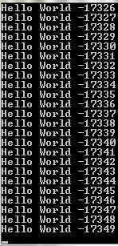
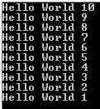
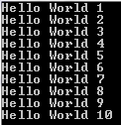
Quiz
int hello(int n)
{
if (n==0)
return 0;
else
printf(“Hello World %d\n”,n);
hello(n-1);
}
What would the program do if I call hello(10)?
What if I call hello(-1)?
What if the order of printf() and hello(10) is reversed?
Does not terminate…

Slide 47
Computing Sum of Arithmetic Progression
Many programs can be written in a recursive way.
int AP(int n)
{
if (n==0)
return 0;
else
return (n+AP(n-1));
}
The way of thinking is quite different.
The idea is very similar to induction.
Always try to reduce it to smaller problems.

Slide 48
Computing Exponential Function
This function is to compute 2^{n}.
int EX(int n)
{
if (n==0)
return 1;
else
return (EX(n-1)+EX(n-1));
}
How many function calls if I run EX(n)?
2^{n} times.
If we replace the last line by return 2EX(n-1),
then the program will compute the same thing,
but there will be only n function calls.

Slide 49
Tower of Hanoi
To move the biggest disk,
we must first move the disks
on top to another post.
Move_{1,2}(n)::= Move_{1,3}(n-1);
biggest disk 12;
Move_{3,2}(n-1)

Slide 50
Tower of Hanoi
Suppose we already have a function T10(a,b) to move 10 disks from pole a to pole b.
It is then easy to write a program for T11(a,b)
T11(a,b)
{
T10(a,c);
printf(“Move Disk 11 from a to c\n”);
T10(c,b);
}
In general you can write exactly the same program for Tn,
if we are given a program for Tn-1.
Instead of writing one program for each n,
we can take n as an input and write a recursive program.

Slide 51
Tower of Hanoi
Tower_of_Hanoi(int origin, int destination, int buffer, int number)
{
if (n==0)
return;
Tower_of_Hanoi(origin, buffer, destination, number-1);
printf(“Move Disk #%d from %d to %d\n”, number, origin, destination);
Tower_of_Hanoi(buffer, destination, origin, number-1);
}
This is the power of recursive thinking.
The program is very short,
yet there is no easy way to write it without recursion

Slide 52
Tower of Hanoi
Tower_of_Hanoi(origin, destination, buffer, number)
T(A,B,C,0)
T(A,C,B,1)
1
T(B,C,A,0)
move 1 from A to C
T(A,B,C,2)
2
T(C,A,B,0)
T(C,B,A,1)
3
move 2 from A to B
T(A,B,C,0)
move 1 from C to B
T(A,C,B,3)
4
Move 3 from A to C.
T(B,C,A,0)
T(B,A,C,1)
5
T(C,A,B,0)
move 1 from B to A
T(B,C,A,2)
6
T(A,B,C,0)
move 2 from B to C
T(A,C,B,1)
7
T(B,C,A,0)
move 1 from A to C

Slide 53
This Lecture
Setting up recurrences
  Fibonacci recurrence
  Catalan recurrence
  Other recurrences
Writing recursive program
Solving recurrences

Slide 54
Solving Recurrence
a₀=1, a_{k} = a_{k-1} + 2
a₁ = a₀ + 2
a₂ = a₁ + 2 = (a₀ + 2) + 2 = a₀ + 4
a₃ = a₂ + 2 = (a₀ + 4) + 2 = a₀ + 6
a₄ = a₃ + 2 = (a₀ + 6) + 2 = a₀ + 8
See the pattern is a_{k} = a₀ + 2k = 2k+1
You can verify by induction.

Slide 55
Solving Hanoi Sequence
a₁=1, a_{k} = 2a_{k-1} + 1
a₂ = 2a₁ + 1 = 3
a₃ = 2a₂ + 1 = 2(2a₁ + 1) + 1 = 4a₁ + 3 = 7
a₄ = 2a₃ + 1 = 2(4a₁ + 3) + 1 = 8a₁ + 7 = 15
a₅ = 2a₄ + 1 = 2(8a₁ + 7) + 1 = 16a₁ + 15 = 31
a₆ = 2a₅ + 1 = 2(16a₁ + 15) + 1 = 32a₁ + 31 = 63
Guess the pattern is a_{k} = 2^{k}-1
You can verify by induction.

Slide 56
Solving Merge Sort Recurrence
T_{2k} <= 2T_{k} + 2k
If we could guess that T_{k} is at most k log₂k,
then we can prove by induction that T_{2k} is at most 2k log₂(2k).
This is because
T_{2k} <= 2T_{k} + 2k
<= 2klog₂k + 2k
= 2k(log₂k + 1)
= 2k(log₂k + log₂2)
= 2klog₂2k
Induction Step

Slide 57
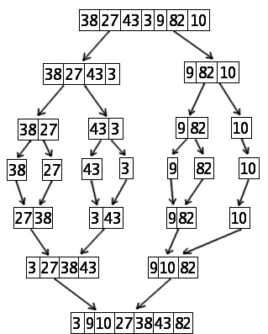
Solving Merge Sort Recurrence
T_{2k} <= 2T_{k} + 2k
How could we guess T_{k} <= k log₂k in the first place?
If there are n numbers there are log₂n levels.
In each level i we need to solve 2^{i-1} merge problems.
Each merge problem in level i has two subseqences
of n/2^{i} numbers, and so can be solved in 2n/2^{i =} n/2^{i-1} steps.
So each level requires a total of (2^{i-1})(n/2^{i-1})=n steps.
Since there are log₂n levels,
the total number of steps is at most nlog₂n.
Divide
Level 3
Level 2
Merge
Level 1
Level 0

Slide 58
Solving Fibonacci Sequence
a₀=0, a₁=1, a_{k} = a_{k-1} + a_{k-2}
a₂ = a₁ + a₀ = 1
a₃ = a₂ + a₁ = 2a₁ + a₀ = 2
a₄ = a₃ + a₂ = 2a₂ + a₁ = 3a₁ + 2a₀ = 3
a₅ = a₄ + a₃ = 2a₃ + a₂ = 3a₂ + 2a₁ = 5a₁ + 3a₀ = 5
a₆ = a₅ + a₄ = 2a₄ + a₃ = 3a₃ + 2a₂ = 5a₂ + 3a₁ = 8a₁ + 5a₀ = 8
a₇ = a₆ + a₅ = 2a₅ + a₄ = 3a₄ + 2a₃ = 5a₃ + 3a₂ = 8a₂ + 5a₁ = 13a₁ + 8a₀ = 13
See the pattern a_{n} = a_{n-k}a_{k+1} + a_{n-k-1}a_{k}
but this does not give a formula for computing a_{n}

Slide 59
Solving Fibonacci Sequence
a_{n} = a_{n-k}a_{k+1} + a_{n-k-1}a_{k}
k=2 =>
a_{n} = a_{n-2}a₃ + a_{n-3}a₂
So, a₇ = a₇₋₂a₃ + a₇₋₃a₂
= a₅a₃ + a₄a₂
= 5a₃ + 3a₂
a_{n} = a_{n-k}a_{k+1} + a_{n-k-1}a_{k}
k=1 =>
a_{n} = a_{n-1}a₂ + a_{n-2}a₁
So, a₇ = a₇₋₁a₂ + a₇₋₂a₁
= a₆a₂ + a₅a₁
= 8a₂ + 5a₁
a₀=0, a₁=1, a_{k} = a_{k-1} + a_{k-2}
a₂ = a₁ + a₀ = 1
a₃ = a₂ + a₁ = 2a₁ + a₀ = 2
a₄ = a₃ + a₂ = 2a₂ + a₁ = 3a₁ + 2a₀ = 3
a₅ = a₄ + a₃ = 2a₃ + a₂ = 3a₂ + 2a₁ = 5a₁ + 3a₀ = 5
a₆ = a₅ + a₄ = 2a₄ + a₃ = 3a₃ + 2a₂ = 5a₂ + 3a₁ = 8a₁ + 5a₀ = 8
a₇ = a₆ + a₅ = 2a₅ + a₄ = 3a₄ + 2a₃ = 5a₃ + 3a₂ = 8a₂ + 5a₁ = 13a₁ + 8a₀ = 13
See the pattern a_{n} = a_{n-k}a_{k+1} + a_{n-k-1}a_{k}
but this does not give a formula for computing a_{n}

Slide 60
Second Order Recurrence Relation
a_{k} = Aa_{k-1} + Ba_{k-2}
A and B are real numbers and B≠0
For example, Fibonacci sequence is when A=B=1.

Slide 61
Geometric-Sequence Solution
a_{k} = Aa_{k-1} + Ba_{k-2}
Find solutions of the form (1, t, t², t³, t⁴, …, t^{n}, …)
That is, suppose a_{k}=t^{k}
t^{k} = At^{k-1} + Bt^{k-2}
t² = At + B
t² - At – B = 0
So t is a root of the quadratic equation t² - At – B = 0.

Slide 62
Example
a_{k} = a_{k-1} + 2a_{k-2}
t² - At – B = 0
A = 1; B = 2
Find solutions of the form (1, t, t², t³, t⁴, …, t^{n}, …)
So t must be a root of the quadratic equation t² - t – 2 = 0.
This implies that t=2 or t=-1.
So solutions of the form (1, t, t², t³, t⁴, …, t^{n}, …) are:
(i) (1,2,4,8,16,32,64,…)
(ii) (1,-1,1,-1,1,-1,…)

Slide 63
Example
a_{k} = a_{k-1} + 2a_{k-2}
So solutions of the form (1, t, t², t³, t⁴, …, t^{n}, …) are:
(i) (1,2,4,8,16,32,64,…)
(ii) (1,-1,1,-1,1,-1,1,…)
2
1
5 | = | 1 | + | 2*2
7 | = | 5 | + | 2*1
17 | = | 7 | + | 2*5
31 | = | 17 | + | 2*7
65 | = | 31 | + | 2*17
Are there other solutions?
Try (2, 1, 5, 7, 17, 31, 65,…)
(0,3,3,9,15,33,63,…)
(4,5,13,23,49,95,193,…)
How to obtain these solutions?

Slide 64
Linear Combination of Two Solutions
If (r₀,r₁,r₂,r₃,…) and (s₀,s₁,s₂,s₃,…) are solutions to a_{k} = Aa_{k-1} + Ba_{k-2},
then the sequence (a₀,a₁,a₂,a₃,…) defined by the formula
a_{k} = Cr_{k} + Ds_{k}
also satisfies the same recurrence relation for any C and D.
This says that any linear combination of two solutions for
the recurrence relation is also a solution for the recurrence.
This is easy to check anyway… see below:
r_{k}
(2, 1, 5, 7, 17, 31, 65,…)
(0, 3, 3, 9, 15, 33, 63,…)
(4, 5, 13, 23, 49, 95, 193,…)
2r_{k}
+
s_{k}
s_{k}
=
a_{k}
a_{k}

Slide 65
Distinct-Roots Theorem
Suppose a sequence (a₀,a₁,a₂,a₃,…) satisfies a recurrence relation
a_{k} = Aa_{k-1} + Ba_{k-2}
If t² - At – B = 0 has two distinct roots r and s,
then a_{n} = Cr^{n} + Ds^{n} for some C and D.
The theorem says that all the solutions of the recurrence relation
are a linear combination of the two series (1,r,r²,r³,r⁴,…,r^{n},…)
and (1,s,s²,s³,s⁴,…,s^{n},…) defined by the distinct roots of t² - At – B = 0.
If we are given a₀ and a₁, then C and D are uniquely determined.

Slide 66
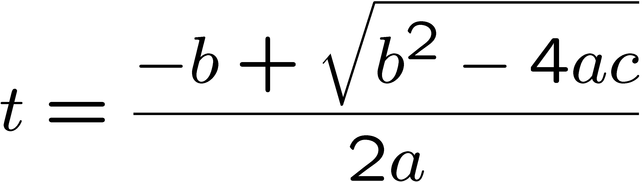
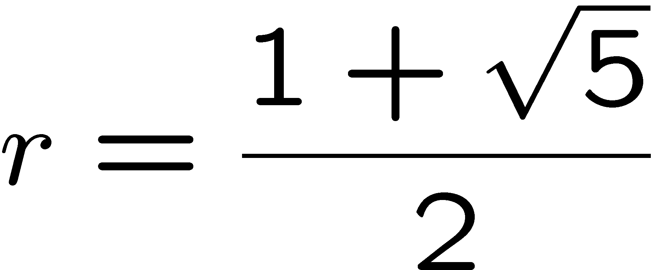
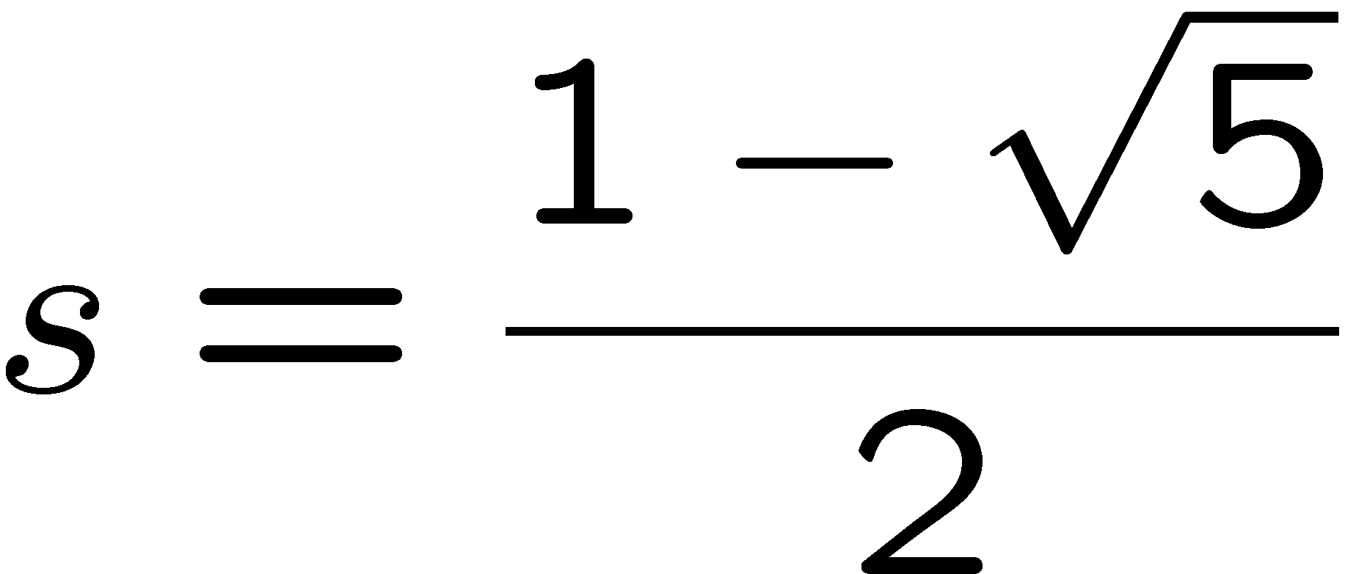
Solving Fibonacci Sequence
a₀=0, a₁=1, a_{k} = a_{k-1} + a_{k-2}
t² - At – B = 0
A = 1; B = 1
First solve the quadratic equation t² - t – 1 = 0.
So the distinct roots are:

Slide 67
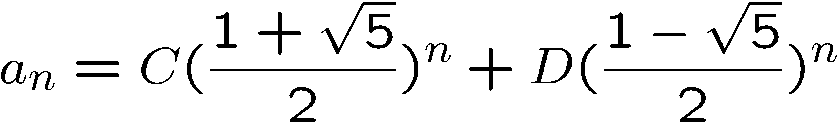

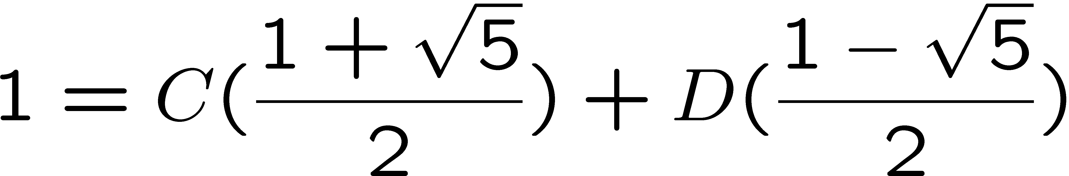
Solving Fibonacci Sequence
a₀=0, a₁=1, a_{k} = a_{k-1} + a_{k-2}
By the distinct-roots theorem, the solutions satisfies the formula:
To figure out C and D, we substitute the value of a₀ and a₁:

Slide 68
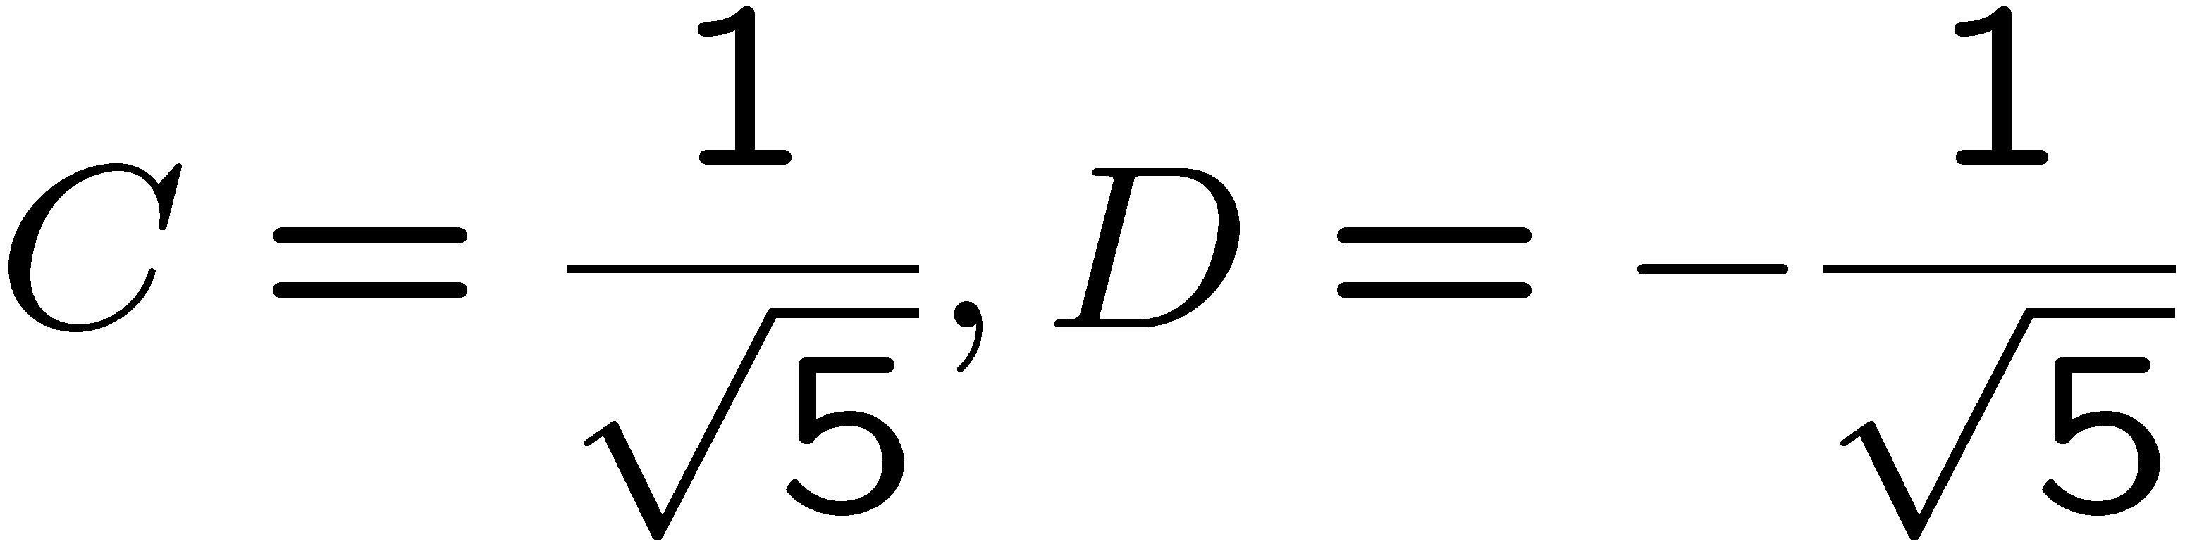
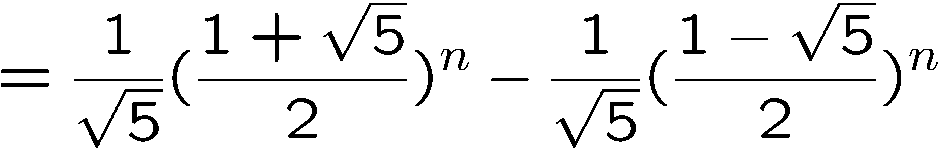
Solving Fibonacci Sequence
Solving these two equations, we get:
Therefore:

Slide 69
Single-Root Case
a_{k} = Aa_{k-1} + Ba_{k-2}
a_{k} = Aa_{k-1} + Ba_{k-2}
Find solutions of the form (1, t, t², t³, t⁴, …, t^{n}, …)
So t is a root of the quadratic equation t² - At – B = 0.
Suppose this quadratic equation has only one root r,
then we know that (1, r, r², r³, r⁴, …, r^{n}, …) satisfies the recurrence relation.
Are there other solutions?

Slide 70
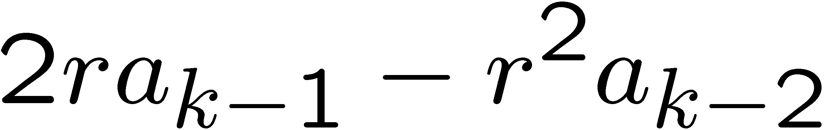


2r² = a₃ = Aa₂ + Ba₁
= Ar
=>A = 2r
3r³ = a₄ = Aa₃ + Ba₂
= A2r² + Br
= 4r³ + Br
=>B = -r³/r = -r²
Another Solution of the Single-Root Case
a_{k} = Aa_{k-1} + Ba_{k-2}
Let r be the single root of the quadratic equation t² - At – B = 0.
(0, r, 2r², 3r³, 4r⁴, …, nr^{n}, …) also satisfies the recurrence relation.
Since r is the single root, A=2r and B=-r².
Therefore we just need to verify that
a_{k} = 2ra_{k-1} - r²a_{k-2}
The right hand side is:
which is equal to the left hand side!

Slide 71
Single-Root Theorem
Suppose a sequence (a₀,a₁,a₂,a₃,…) satisfies a recurrence relation
a_{k} = Aa_{k-1} + Ba_{k-2}
If t² - At – B = 0 has only one root r,
then a_{n} = Cr^{n} + Dnr^{n} for some C and D.
The theorem says that all the solutions of the recurrence relation
are a linear combination of the two series (1,r,r²,r³,r⁴,…,r^{n},…)
and (0,r,2r²,3r³,4r⁴,…,nr^{n},…) defined by the only root of t² - At – B = 0.
If we are given a₀ and a₁, then C and D are uniquely determined.

Slide 72
Exercise
a₀=1, a₁=3, a_{k} = 4a_{k-1} - 4a_{k-2}
Solve the quadratic equation t² – 4t + 4. The only solution is t=2.
By the single-root theorem, all solutions are of the form
a_{n} = C2^{n} + Dn2^{n}.
Pluging in a₀ and a₁…
1 = a₀ = C2⁰ + D*0*2⁰ = C
C = 1
3 = a₁ = C2¹ + D*1*2¹ = 2C + 2D =2 + 2D
2D = 1
D = ½
a₀=1
a₁=3
we solve C=1 and D=1/2.
So, a_{n} = 2^{n} + n2^{n-1}.

Slide 73
Quick Summary
Recursion is a very useful and powerful technique in computer science.
It is very important to learn to think recursively,
by reducing the problem into smaller problems.
This is a necessary skill to acquire to become a professional programmer.
Make sure you have more practices in setting up recurrence relations.

